Slide 1
Serverless Compute on Azure
Speaker name

Slide 2
Agenda
Azure Container Instances
Azure Logic Apps
Azure Functions

Slide 3
Azure Container Instances
Provides hypervisor-like isolation of a container
Allows custom resource sizing per container
Direct public IP access
Easy mounting of Azure Files shares
Can schedule groups of containers sharing the same resources and clusters

Slide 4
Azure Logic App

Slide 5
Getting Started
Designer Options
Web based designer
Visual Studio 2015 and 2017 Plugin
Deployment Options
Promotion using the Web Designer
Azure Resource Manager Templates and Powershell

Slide 6
Connectors

Slide 7

Triggers
Triggers are used to initiate a Logic App. Triggers can be broke down into two main types, reactive and proactive

Slide 8
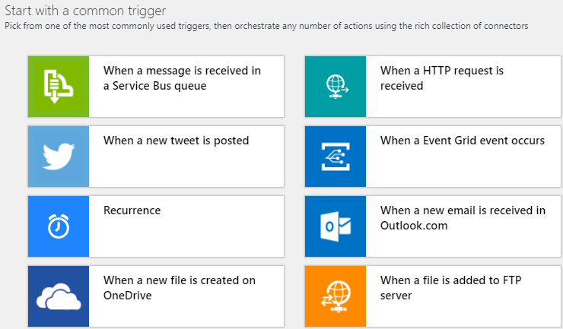
Logic Apps - Triggers
Common Trigger Templates

Slide 9
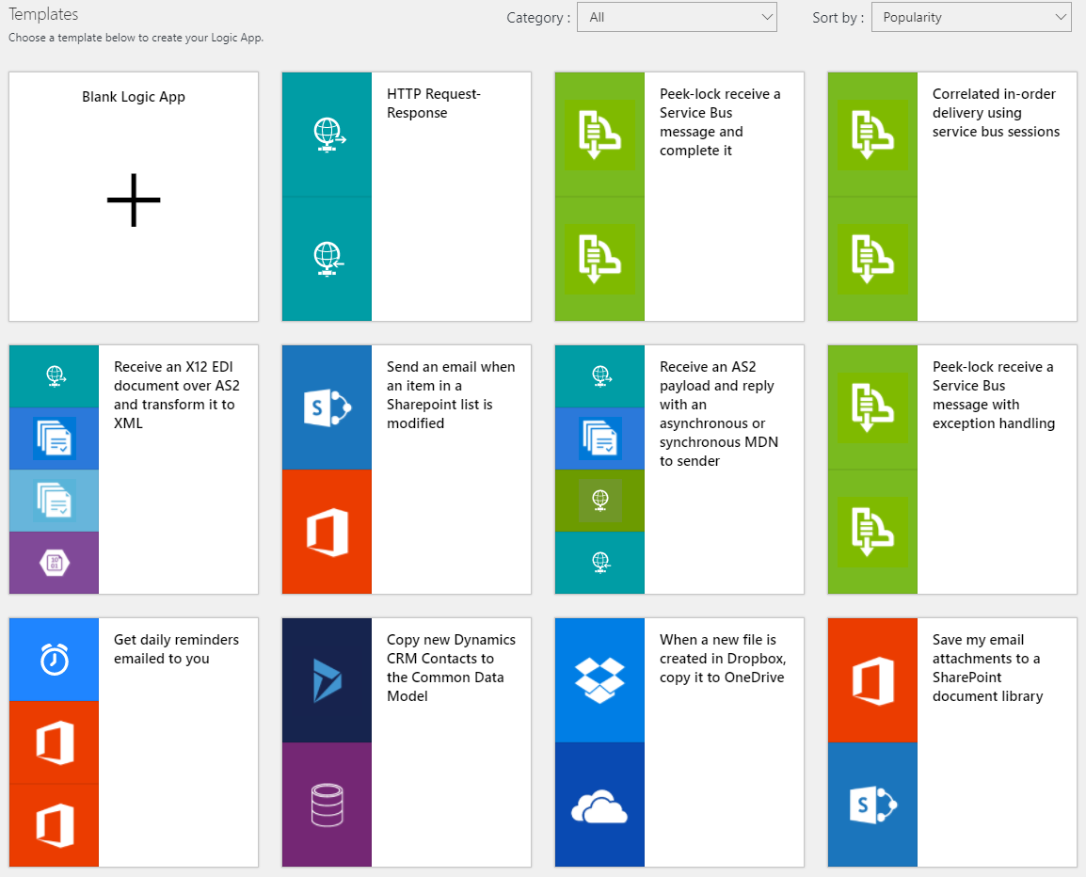
Logic Apps - Triggers
Pre Built Quick Start Templates

Slide 10
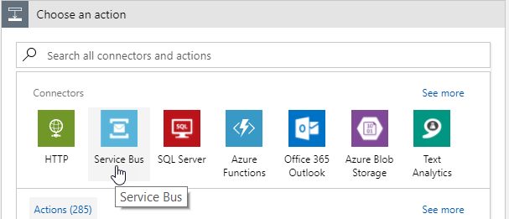
Logic Apps - Triggers
Custom Select Actions with Triggers

Slide 11
Actions

Slide 12
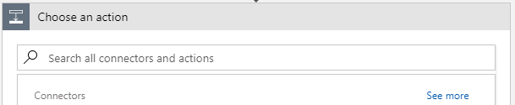
Logic Apps - Actions
Search Actions

Slide 13
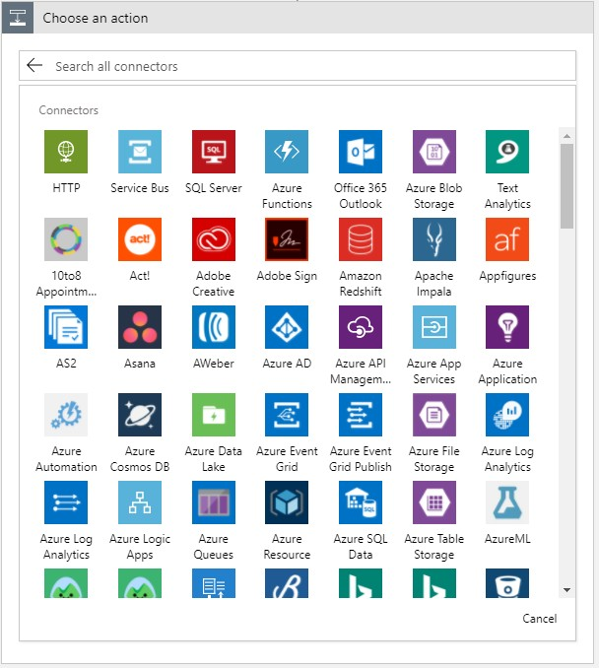
Logic Apps - Actions
List by connectors

Slide 14
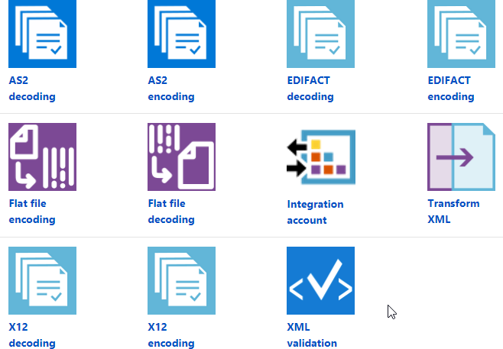
Logic Apps - Actions
Premium actions through integration accounts

Slide 15
Flow Control

Slide 16
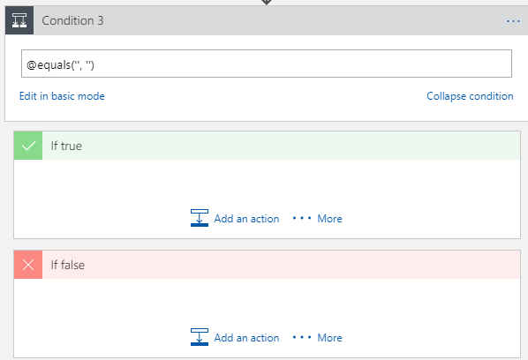
Logic Apps - Flow control
If Then

Slide 17
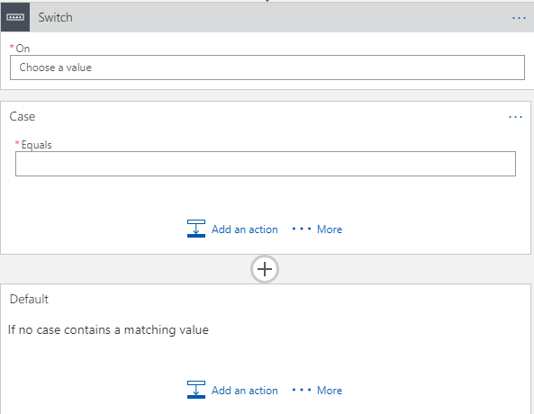
Logic Apps - Flow control
Switch

Slide 18
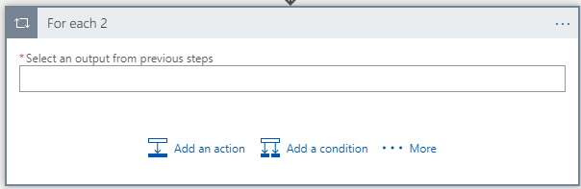
Logic Apps - Flow control
For each

Slide 19
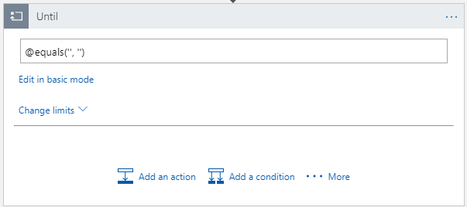
Logic Apps - Flow control
Do until

Slide 20
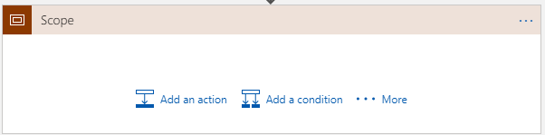
Logic Apps - Flow control
Scope

Slide 21
Azure Functions

Slide 22




Azure Functions = Events + Code
Time
Run a background task on a regular schedule
Data
Process messages in a queue or new items in blob storage
Web Respond to a HTTP request or webhook

Slide 23
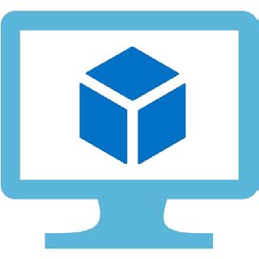


But Can’t We Already Do That?
Azure Virtual Machines
Azure Cloud Services
Azure Web Apps & Web Jobs

Slide 24

Azure Virtual Machines
Install whatever you want
Web servers, Windows services, etc
Infrastructure as a service (IaaS)
Complete control of the server
Choose your operating system
You are responsible
Patching and maintaining
Scaling

Slide 25
Azure Cloud Services
Web Roles
Worker Roles
IIS and .NET pre-installed Automatic Scaling

Slide 26
Azure Web Applications & Web Jobs
Easy to deploy
Choice of many frameworks Hosted in a “hosting plan”
Combine many sites on one server
Scale up to many servers
Web Jobs
Simplified background tasks
The basis for Azure Functions

Slide 27

Azure Functions
Simplified programming model
Just the code to respond to the event
No boilerplate
Focus on the business requirements
New pricing model
Pay as you go
Only pay for what you use

Slide 28

Azure Functions Pricing
You can still use existing app service plans
“Dedicated” service plan
Predictable monthly costs
Or you can use the “Consumption” plan
Also known as “Dynamic”
Pay for what you use

Slide 29

Consumption Plan
Billing Model
Number of executions
CPU Time (s) x RAM (GB)
Free monthly grant
1,000,000 executions
- 400,000 GB-s

Slide 30

Cutting Costs
Consumption Plan
Limited to five minutes per execution
Optional daily quota in GBs
Reduce your costs with
Fewer invocations
Faster invocation times
Reduced memory requirements

Slide 31

What Are the Benefits of Azure Functions?
Rapid and simple development
Code within the portal
Eliminate boilerplate
All the power of Azure Web Apps
CI, Kudu, Easy Auth, Certs, Custom Domains, Settings etc
Cost effective pricing
Pay for what you use
No servers to maintain
Automatic scaling

Slide 32
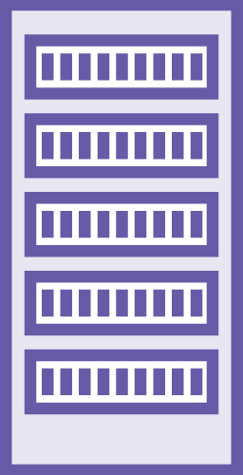
What Is Serverless?
There are still servers (of course!)
You delegate the management of them
Use third party PaaS wherever possible
e.g. DocumentDb, Auth0
Run your custom code on Azure Functions
Respond to events
Functions as a Service (FaaS)

Slide 33
Azure Function Use Cases
Experiments and prototyping
Automating development processes
Decomposing or extending monolithic applications
Independent scaling
Adapters for integrating systems Go serverless!

Slide 34
Explore with Hands on Lab

